Slide 1
Demand, Supply, and Market Equilibrium
Chathuranga Adhikari
B.com (Sp)(Hons), M.com

Slide 2

Learning Outcomes
Identify the circular flow of economic activities
Define demand and supply
Define market equilibrium
Identify the graphical illustration of demand, supply, and equilibrium
Identify the changes in demand, supply, and equilibrium

Slide 3
The basic decision-making units
A firm is an organization that transforms resources (inputs) into products (outputs). Firms are the primary producing units in a market economy.
An entrepreneur is a person who organizes, manages, and assumes the risks of a firm, taking a new idea or a new product and turning it into a successful business.
Households are the consuming units in an economy.

Slide 4
The circular flow of economic activity
The circular flow of economic activity shows the connections between firms and households in input and output markets

Slide 5
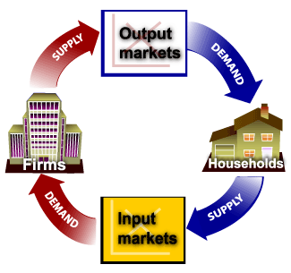
Input market and output market
Output, or product, markets are the markets in which goods and services are exchanged.
Input markets are the markets in which resources- labor, capital, and land used to produce products, are exchanged.
Payments flow in the opposite direction as the physical flow of resources, goods, and services (counterclockwise).

Slide 6
Input Market (Factor Market)
Input markets include:
The labor market, in which households supply work for wages to firms that demand labor.
The capital market, in which households supply their savings, for interest or for claims to future profits, to firms that demand funds to buy capital goods.
The land market, in which households supply land or other real property in exchange for rent.

Slide 7
Determinants of Household Demand
A household’s decision about the quantity of a particular output to demand depends on:
The price of the product in question.
The income available to the household.
The household’s amount of accumulated wealth.
The prices of related products available to the household.
The household’s tastes and preferences.
The household’s expectations about future income, wealth, and prices.

Slide 8

Demand
The various amounts of a product (goods or services) that consumers are willing and able to purchase at various prices during some specific period
Demonstrated by the low of demand, the demand schedule and demand curve

Slide 9
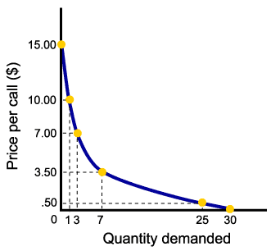
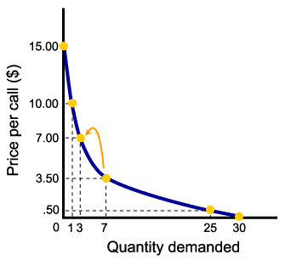


The Law of Demand
The law of demand states that there is a negative, or inverse, the relationship between price and the quantity of a good demanded and its price.
This means that demand curves slope downward.

Slide 10
The demand schedule
Price per Unit | Quantity demanded
5 | 10
4 | 20
3 | 35
2 | 55
1 | 80
A demand schedule is a table showing how much of a given product a household would be willing to buy at different prices.
Demand curves are usually derived from demand schedules.

Slide 11
The Demand Curve
P
D₁
a
The demand curve is a graph illustrating how much of a given product a household would be willing to buy at different prices.
5
4
3
2
1
b
c
Price ($ per unit)
d
e
D₁
0
Q
10 20 30 40 50 60 70 80

Slide 12

Demand Equation
Q d = a - b P

Slide 13
Question 01
Price of Pizza Slice | Number of Pizza Slice Demanded
$ 0.5 | 8
$0.75 | 7
$1.00 | 6
$1.25 | 5
$1.50 | 4
$1.75 | 3
$2.00 | 2
Derive the demand equation

Slide 14
Question 02
Price | Demand
0 | 100
1 | 80
2 | 60
4 | 20
5 | 0
Derive the demand equation

Slide 15
Question 03
    Qd = 100-5P
Derive the demand schedule and draw the graph

Slide 16
Question 04
    Qd = 2200-200P
Derive the demand schedule and draw the graph

Slide 17
Question 05
Price
280
0
28
Quantity
Derive the demand equation and schedule

Slide 18
Question 06
Price
50
0
150
Quantity
Derive the demand equation and schedule

Slide 19
Demand function
A demand function is a causal relationship between a dependent variable (i.e., quantity demanded) and various independent variables (i.e., factors that are believed to influence quantity demanded)
Qd x = 𝑓 (Px, Y, P 1 …. P n − 1, T, Pe, S)
Price of the commodity (P x)
Income (Y)
Price of Related Goods (P 1 …. P n-1)
Tastes and Preferences (T)
Expectations (Pe)
Social factors (S)

Slide 20
Income and Wealth
Income is the sum of all households’ wages, salaries, profits, interest payments, rents, and other forms of earnings in a given period of time. It is a flow measure.
Wealth, or net worth, is the total value of what a household owns minus what it owes. It is a stock measure.

Slide 21

Related Goods and Services
Normal Goods are goods for which demand goes up when income is higher and for which demand goes down when income is lower.
Inferior Goods are goods for which demand falls when income rises.

Slide 22

Which of the following goods are likely to be classified as normal goods or services? Inferior? Defined your answer.
Chocolate
Public Transportation
Used cars
Mobile phone
Computers
Bicycle
Movie theaters
Dog shows
Organic food
Pizza
Legal services

Slide 23

Related Goods and Services
Substitutes are goods that can serve as replacements for one another; when the price of one increases, demand for the other goes up. Perfect substitutes are identical products.
Complements are goods that “go together”; a decrease in the price of one results in an increase in demand for the other, and vice versa.

Slide 24

Which of the following pairs of goods are likely to be classified as substitutes? Complements? Defined your answer.
Bread and Butter
PlayStation and Games
Nike brand and Reebok brand sneakers
IBM and Apple brand computers
Dress shirts and ties
Dominos and Pizza hut
Vehicle and fuel
Beer and wine
Faxes and e-mail
Cereal and milk

Slide 25
Shift of Demand VS Movement along a Demand Curve
A change in the price of a good or service leads to a Change in quantity demanded (movement along the demand curve).
Change in income, preferences, or prices of other goods or services leads to Change in demand (shift of the demand curve).

Slide 26
Change in Demand and Change in quantity Demand
Caused by changes in one or other of the non-price determinants of demand
Represented as a shift of the demand curve either to the right or left
Represents a change in the quantity demand at every price, so cannot be related to a change in price

Slide 27
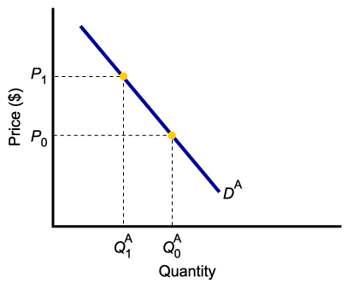
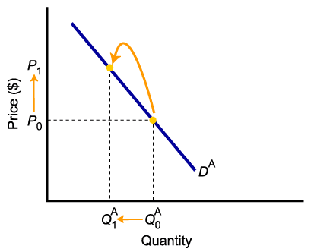
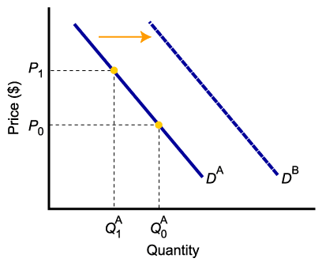
The shift of Demand Versus Movement Along a Demand Curve
A change in demand is not the same as a change in quantity demanded.
In this example, a higher price causes a lower quantity demanded.
Changes in determinants of demand, other than price, cause a change in demand, or a shift of the entire demand curve, from D_{A} to D_{B}.

Slide 28
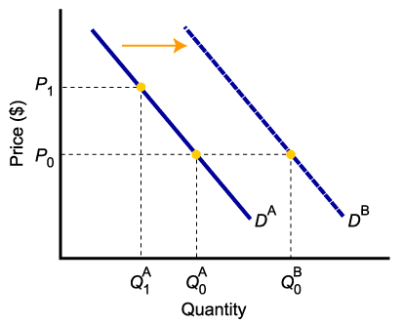
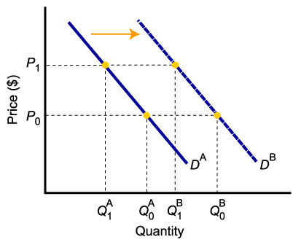
A Change in Demand Versus a Change in Quantity Demanded
When demand shifts to the right, demand increases. This causes the quantity demanded to be greater than it was prior to the shift, for each and every price level.

Slide 29
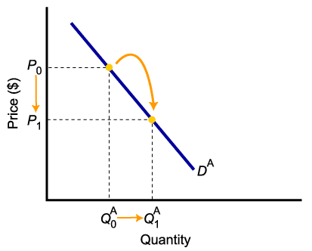
A Change in Demand Versus a Change in Quantity Demanded
To summarize:
Change in price of a good or service
leads to
Change in quantity demanded
(Movement along the curve).
Change in income, preferences, or
prices of other goods or services
leads to
Change in demand
(Shift of curve).

Slide 30
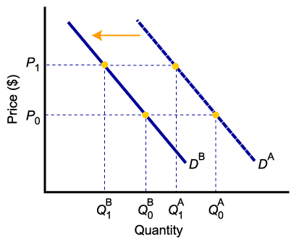
The Impact of a Change in Income
Higher-income decreases the demand for an inferior good
Higher-income increases the demand for a normal good

Slide 31
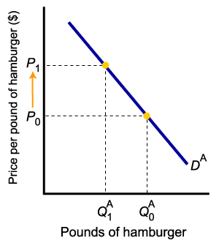
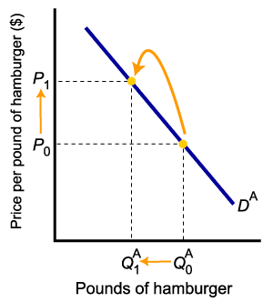
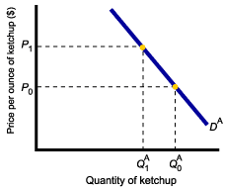
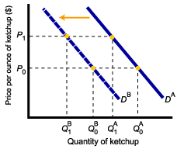
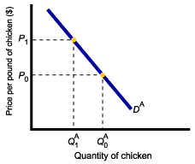
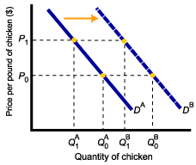
The Impact of a Change in the Price of Related Goods
Demand for complement good (ketchup) shifts left
Demand for a substitute good (chicken) shifts right
The price of hamburgers rises
The quantity of hamburgers demanded falls

Slide 32
From Household to Market Demand
Demand for a good or service can be defined for an individual household, or for a group of households that make up a market.
Market demand is the sum of all the quantities of a good or service demanded per period by all the households buying in the market for that good or service.

Slide 33
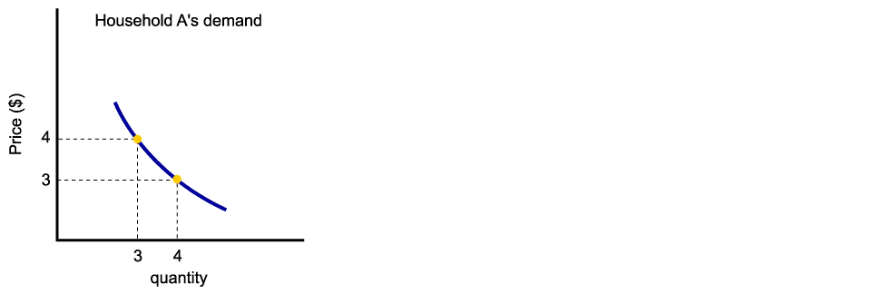
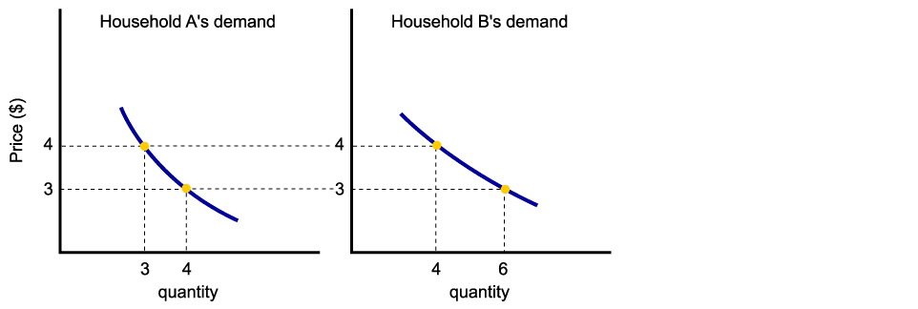
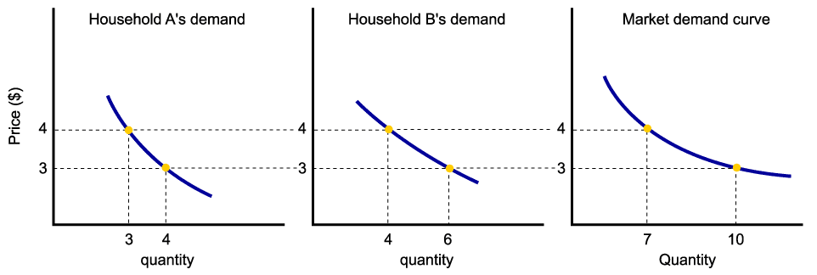
From Household Demand to Market Demand
Assuming there are only two households in the market, market demand is derived as follows:

Slide 34
EXERCISE
Explain what will happen to pizza demand in each scenario using graphs.
Increase in income of households
Increase in price of pizza
Increase in the price of cheese
Decrease in price of burgers
Customers’ preference for pizza reduced

Slide 35

Supply
Amount of goods or services that sellers are willing and able to sell at the price level.

Slide 36
Supply in Output Markets
A supply schedule is a table showing how much of product firms will supply at different prices.
Quantity supplied represents the number of units of a product that a firm would be willing and able to offer for sale at a particular price during a given time period.
Price per Unit | Quantity Supplied
5 | 12,000
4 | 10,000
3 | 7,000
2 | 4,000
1 | 1,000

Slide 37
The Supply Curve and the Supply Schedule
P
a
5
4
3
2
1
S₁
A supply curve is a graph illustrating how much of a product a firm will supply at different prices.
b
c
Price ($ per unit)
d
e
S₁
Q
0
2 4 6 8 10 12 14 16
Quantity supplied (000/week)

Slide 38
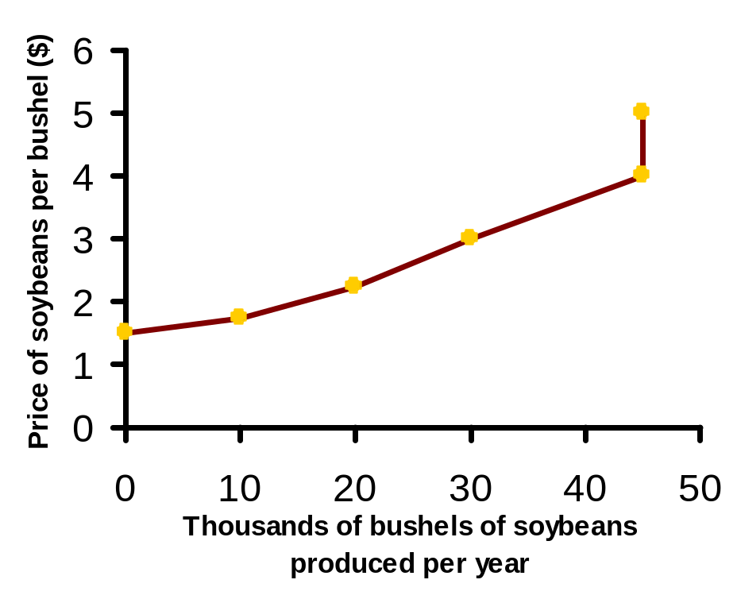

The Law of Supply
The law of supply states that there is a positive relationship between the price and quantity of a good supplied.
This means that supply curves typically have a positive slope.

Slide 39
Supply Equation
Q s = a + b P

Slide 40
Supply function
A supply function is a causal relationship between a dependent variable (i.e., quantity supplied) and various independent variables (i.e., factors that are believed to influence quantity supplied)
Qd x = 𝑓 (Px, Pf, P 1 …. P n − 1, T, E, G)
  Price of the commodity (P x)
  Price of factors of production or inputs (Pf)
  Price of Related Goods (P 1 …. P n-1)
  Technology (T)
  Expectations of the supplier (E)
  Government Policies (G)

Slide 41
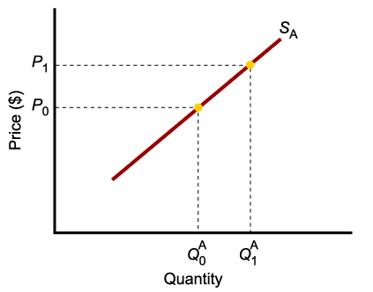
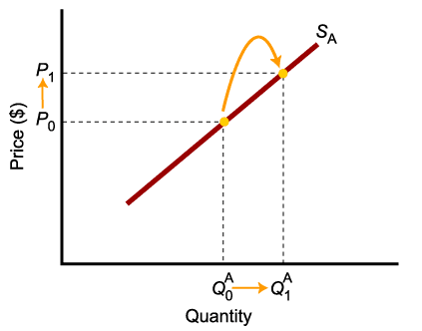
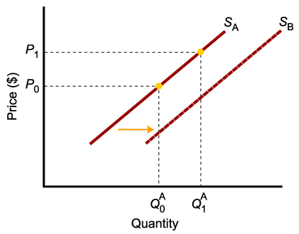
A Change in Supply Versus a Change in Quantity Supplied
A change in supply is not the same as a change in quantity supplied.
In this example, a higher price causes higher quantity supplied, and a move along the demand curve.
In this example, changes in determinants of supply, other than price, cause an increase in supply, or a shift of the entire supply curve, from S_{A} to S_{B}.

Slide 42
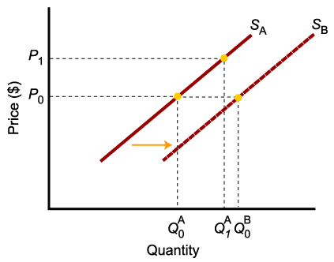
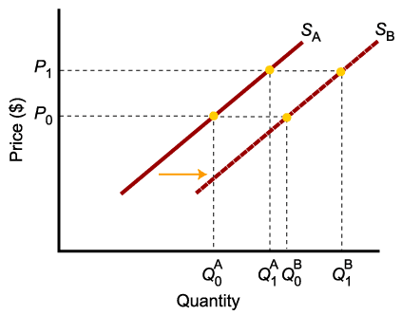
A Change in Supply Versus a Change in Quantity Supplied
When supply shifts to the right, supply increases. This causes the quantity supplied to be greater than it was prior to the shift, for each and every price level.

Slide 43

A Change in Supply Versus a Change in Quantity Supplied
To summarize:
Change in price of a good or service
leads to
Change in quantity supplied
(Movement along the curve).
Change in costs, input prices, technology, or prices of related goods and services
leads to
Change in supply
(Shift of curve).

Slide 44
From Individual Supply to Market Supply
The supply of a good or service can be defined for an individual firm, or for a group of firms that make up a market or an industry.
Market supply is the sum of all the quantities of a good or service supplied per period by all the firms selling in the market for that good or service.

Slide 45
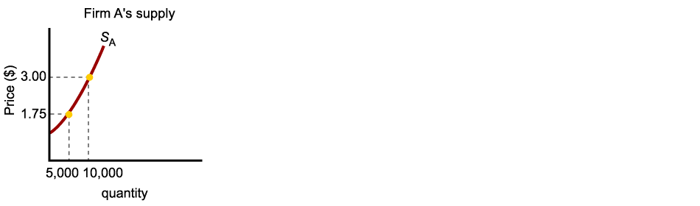
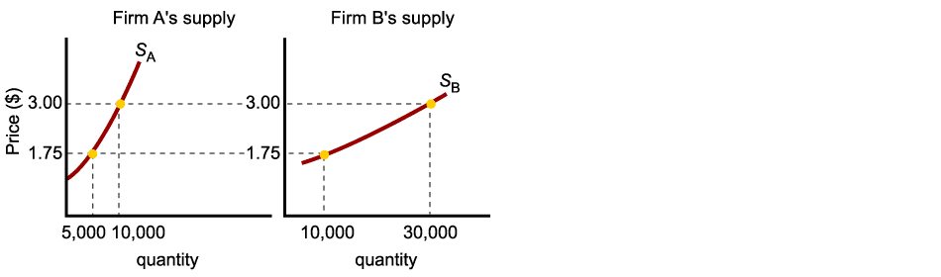
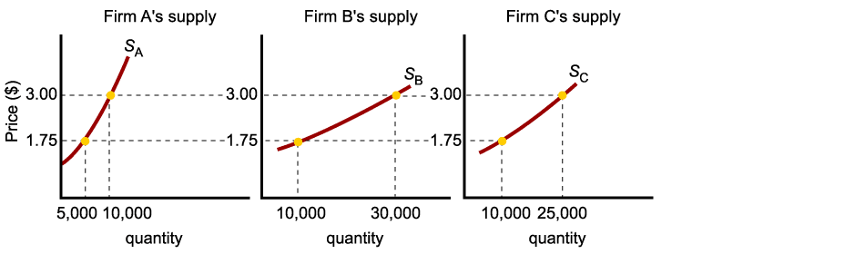
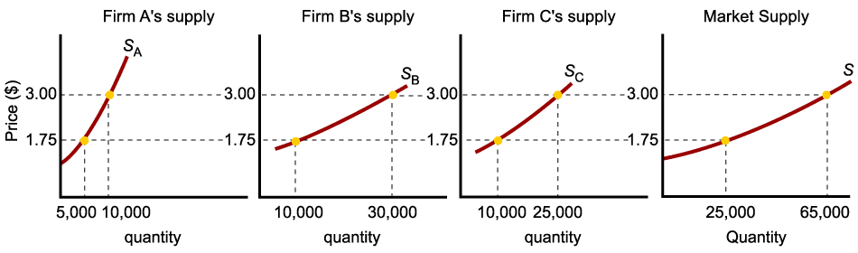
Market Supply
As with market demand, market supply is the horizontal summation of individual firms’ supply curves.

Slide 46
Market Equilibrium
The operation of the market depends on the interaction between buyers and sellers.
An equilibrium is a condition that exists when the quantity supplied and quantity demanded are equal.
At equilibrium, there is no tendency for the market price to change.

Slide 47
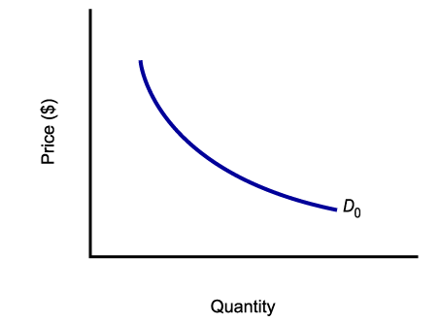
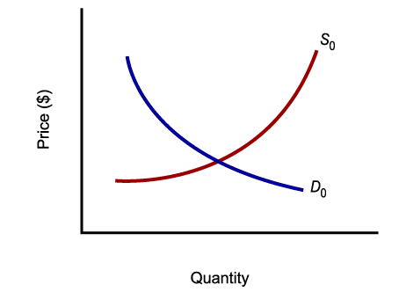
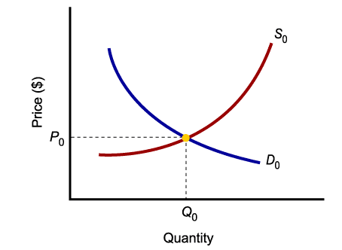
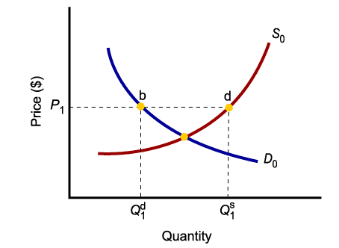
Market Equilibrium
Only in equilibrium is the quantity supplied equal to the quantity demanded.
At any price level other than P₀, the wishes of buyers and sellers do not coincide.

Slide 48
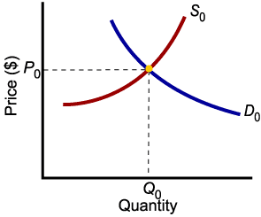
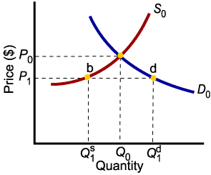
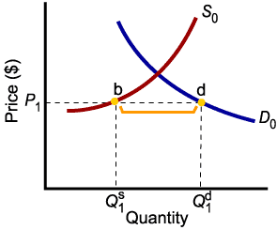
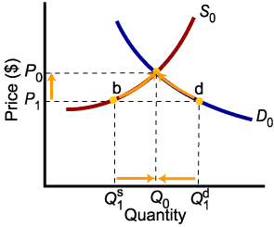
Market Disequilibrium
Excess demand, or shortage, is the condition that exists when the quantity demanded exceeds the quantity supplied at the current price.
When the quantity demanded exceeds the quantity supplied, the price tends to rise until equilibrium is restored.

Slide 49
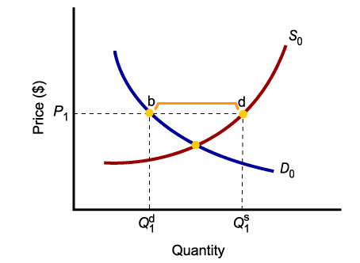
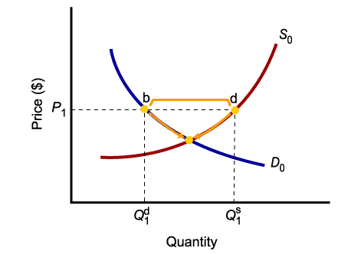
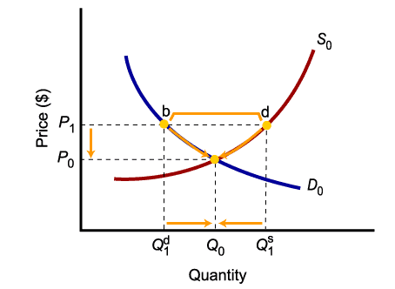
Market Disequilibrium
Excess supply, or surplus, is the condition that exists when quantity supplied exceeds quantity demanded at the current price.
When the quantity supplied exceeds the quantity demanded, the price tends to fall until equilibrium is restored.

Slide 50
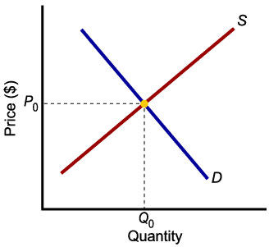
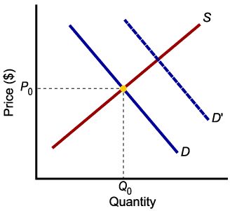
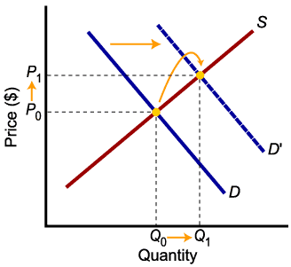

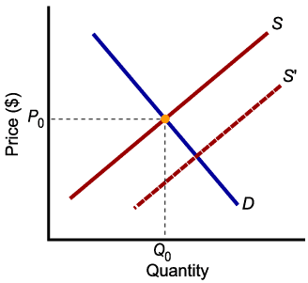
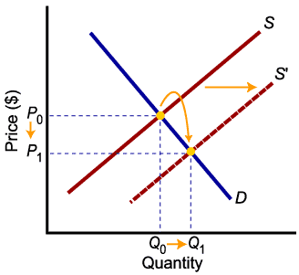
Increases in Demand and Supply
Higher demand leads to higher equilibrium prices and higher equilibrium quantity.
Higher supply leads to lower equilibrium prices and higher equilibrium quantity.

Slide 51

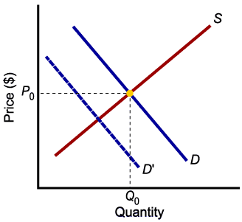
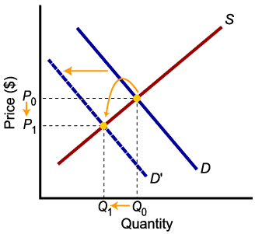

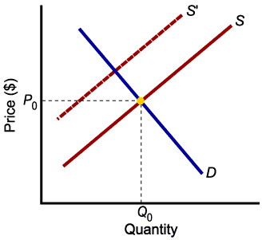
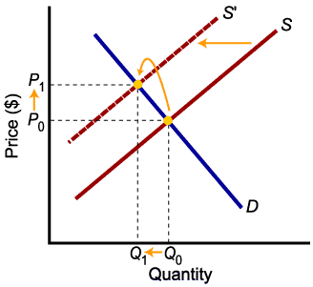
Decreases in Demand and Supply
Lower demand leads to lower prices and lower quantity exchanged.
Lower supply leads to higher prices and lower quantity exchanged.

Slide 52
Exercise 01
Price | Demand | Supply
2 | 16 | -6
3 | 14 | -4
4 | 12 | -2
5 | 10 | 0
6 | 8 | 2
7 | 6 | 4
7.5 | 5 | 5
8 | 4 | 6
9 | 2 | 8
10 | 0 | 10
Demand and Supply schedule of product X is given below
Compute the equations for Quantity demanded and quantity supplied.
What is the equilibrium price?
What is the equilibrium quantity?
Find the Equilibrium price and quantity through a graphical format.

Slide 53
Exercise 02
Here are the equations for the demand and supply curves:
Demand curve: Qd =3300-2P
Supply curve: Qs =500+8P
Compute the equilibrium price and quantity.
Graphically illustrate and find the equilibrium values.

Slide 54
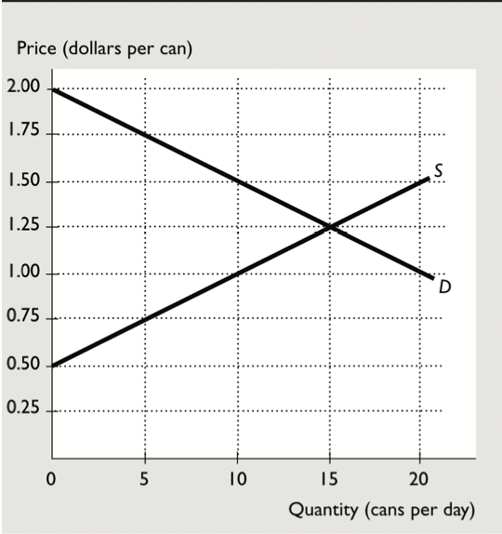
Exercise 03
Calculate the equilibrium levels by using equations.
In market equilibrium, what is the consumer surplus and producer surplus?
Is the market for soft drinks efficient? Why?
If the government restricted producers to 10 cans of soft drinks a day, would the market for soft drinks be efficient? Why?
In the situation described in part 4, what is the deadweight loss?
If the government passed a law requiring producers of soft drinks to sell 20 cans a day, would the market for soft drinks be efficient? Why or why not?
In the situation described in part 6, what is the deadweight loss?

Slide 55

Thank you
Any Question?

